Slide 1

PREDICTION OF HEART DISEASE

Slide 2
PREDICTION OF CARDIOVASCULAR DISEASES USING MACHINE LEARNING
BATCH 18
DONE BY
APARNA L (211419104014)
PREETHI K (211419104201)
GUIDED BY
Mrs. M SANGEETHA
Associate Professor

Slide 3
INTRODUCTION
Machine learning (ML) is a type of artificial intelligence (AI) that allows software applications to become more accurate at predicting outcomes without being explicitly programmed to do so.
Our project can help predict the people who are likely to diagnose with a heart disease by help of their medical report.
This project uses Machine Learning Algorithms namely :
(1) Logistic regression, (2) KNN and (3) SVC
and non linear ML Algorithms (4) Decision Tree Classifier
(5) Random Forest Classifier (6) Gradient Boost Classifier
The objective of this project is to check whether the patient is likely to be diagnosed with any cardiovascular heart diseases based on their medical attributes such as gender, age, chest pain, cholesterol etc.
The given heart disease prediction system enhances medical care and reduces the cost. This project gives us significant knowledge that can help us predict the patients with heart disease.

Slide 4
LITERATURE SURVEY
AUTHOR | YEAR | TITLE | ADVANTAGES | DISADVANTAGES
Senthilkumar Mohan , Chandrasegar Thirumalai , Gautam Srivastava | 2019 | Effective Heart Disease Prediction Using Hybrid Machine Learning Techniques | Propose a novel method that aims at finding significant features by applying machine learning techniques resulting in improving the accuracy in the prediction of cardiovascular disease | The score overestimates CVD risk, potentially leading to overtreatment.
https://ieeexplore.ieee.org/document/8740989

Slide 5
LITERATURE SURVEY
AUTHOR | YEAR | TITLE | ADVANTAGES | DISADVANTAGES
Jian Ping Li; Amin Ul Haq; Salah Ud Din; Jalaluddin Khan; Asif Khan; Abdus Saboor | 2020 | Heart Disease Identification Method Using Machine Learning Classification in E Health care | Proposed novel fast conditional mutual information feature selection algorithm to solve feature selection problem. The features selection algorithms are used for features selection to increase the classification accuracy and reduce the execution time of classification system. | The proposed method should be further validated using multi-center datasets and evaluated prospectively
https://ieeexplore.ieee.org/document/9112202

Slide 6
LITERATURE SURVEY
AUTHOR | YEAR | TITLE | ADVANTAGES | DISADVANTAGES
Norma Latif Fitriyani; Muhammad Syafrudin; Ganjar Alfian; Jongtae Rhee | 2020 | An Effective Heart Disease Prediction Model for Clinical Decision Support System | The proposed model outperformed other models and previous study results by achieving accuracies of 95.90% and 98.40%. Two publicly available datasets (Statlog and Cleveland) were used to build the model and compare the results with those of other models and of previous study results. | Generating multiple classifiers using different subsets of the dataset can increase the flexibility of the method, leading to the reduced information used for the training of each classifier. Thus, a sufficient amount of data is required to ensure the effectiveness of the prediction mode
https://ieeexplore.ieee.org/document/9144587

Slide 7
LITERATURE SURVEY
AUTHOR | YEAR | TITLE | ADVANTAGES | DISADVANTAGES
Sarria E. A. Ashri; M. M. El-Gayar; Eman M. El-Daydamony | 2021 | Heart Disease Prediction Framework based on Hybrid Classifiers and Genetic Algorithm | Proposed HDPM by integrating DBSCAN outlier detection, SMOTE-ENN, and XGBoost to improve prediction accuracy | Some challenges like overfitting and underfitting need to be overcome while building the model
https://ieeexplore.ieee.org/document/9585496

Slide 8
LITERATURE SURVEY
AUTHOR | YEAR | TITLE | ADVANTAGES | DISADVANTAGES
Mohammad Ayoub Khan; Fahad Algarni | 2020 | A Health care Monitoring System for the Diagnosis of Heart Disease in the IoMT Cloud Environment using MSSO- ANFIS | To improve prediction accuracy, an IoMT framework for the diagnosis of heart disease using modified salp swarm optimization (MSSO) and an adaptive neuro-fuzzy inference system (ANFIS) is proposed | For heart failure and cardiac arrhythmias, we could not perform meta-analytic approaches due to the small number of studies for each model
https://ieeexplore.ieee.org/document/9131756

Slide 9
PROBLEM STATEMENT
Heart disease is the number one cause of death globally. Heart disease is concertedly contributed by hypertension, diabetes, overweight and unhealthy lifestyles.
With the right treatment, the symptoms of heart disease can be reduced and the functioning of the heart improved.
The predicted results can be used to prevent and thus reduce cost for surgical treatment and other expensive.
The overall objective of my work will be to predict accurately with few tests and attributes the presence of heart disease. Attributes considered form the primary basis for tests and give accurate results more or less.

Slide 10
DEVELOPMENT ENVIRONMENT
SOFTWARE REQUIREMENTS
Google Colab
Google Chrome
OS: Windows 7 SP1
HARDWARE REQUIREMENTS
Memory: 8 GB
Graphics Card: AMD Radeon RX 480
CPU: Intel Core i5-4590
File Size: 2 GB

Slide 11
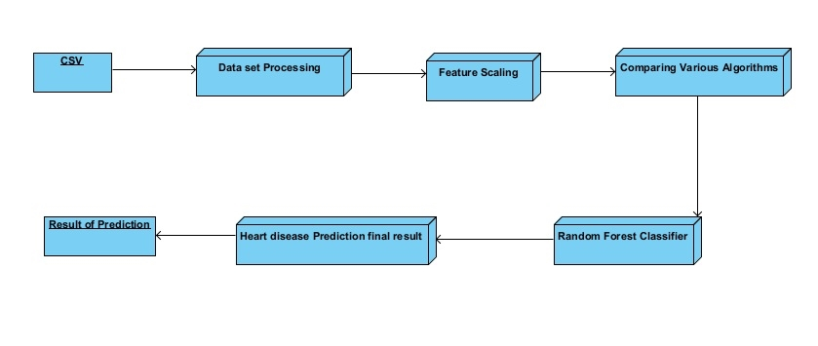
SYSTEM ARCHITECTURE

Slide 12
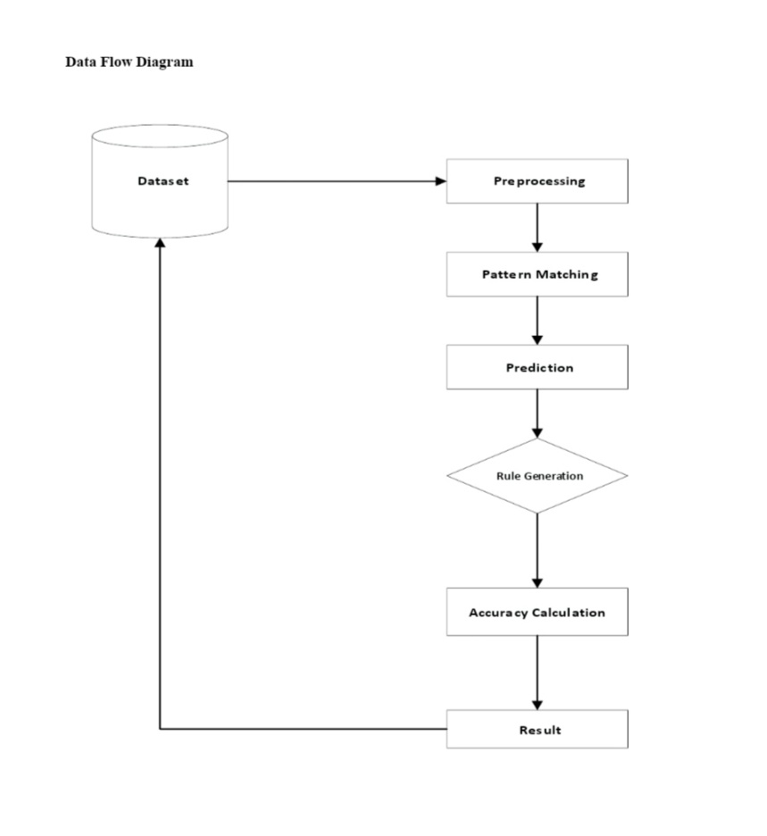
SYSTEM DESIGN – DATA FLOW DIAGRAM

Slide 13
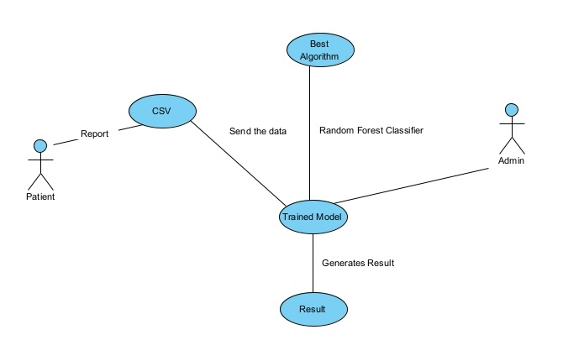
USE CASE DIAGRAM

Slide 14
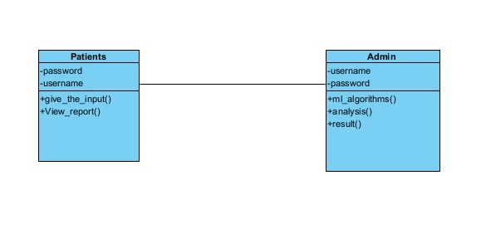
CLASS DIAGRAM

Slide 15
MODULES
Data Processing
Encoding Categorical Data
Feature Scaling
Splitting The Dataset Into The Training Set And Test Set
VARIOUS ALGORITHMS USED
Logistic Regression
SVC (Support Vector Classifier)
K Neighbours Classifier
Random Forest Classifier
Gradient Boosting Classifier
Prediction

Slide 16
DATA SETS
Age : Age of the patient
Sex : Sex of the patient
exang: exercise induced angina (1 = yes; 0 = no)
ca: number of major vessels (0-3)
cp : Chest Pain type chest pain type
Value 1: typical angina
Value 2: atypical angina
Value 3: non-anginal pain
Value 4: asymptomatic
trtbps : resting blood pressure (in mm Hg)
chol : cholestoral in mg/dl fetched via BMI sensor
fbs : (fasting blood sugar > 120 mg/dl) (1 = true; 0 = false)
rest_ecg : resting electrocardiographic results
Value 0: normal
Value 1: having ST-T wave abnormality
Value 2: showing probable or definite left ventricular hypertrophy by Estes' criteria
thalach : maximum heart rate achieved
target : 0= less chance of heart attack 1= more chance of heart attack

Slide 17
MODULE DESCRIPTION
DATA PROCESSING
Data Processing is the task of converting data from a given form to a much more usable and desired form i.e. making it more meaningful and informative.
The collected data can be in a raw form which can’t be directly fed to the machine.
So, this is a process of collecting datasets from different sources, analyzing these datasets and then constructing a new dataset for further processing and exploration. This preparation can be performed either manually or from the automatic approach.

Slide 18
ENCODING CATEGORICAL DATA
Most data can be categorized into 4 basic types from a Machine Learning perspective: numerical data, categorical data, time-series data, and text.
Here , in this project we have two types of data which are numerical data and categorical data .
Numerical data is used to mean anything represented by numbers (floating point or integer).
Categorical data generally means everything else and in particular discrete labeled groups are often called out
Encoding categorical data is a process of converting categorical data into integer format so that the data with converted categorical values can be provided to the models to give and improve the predictions

Slide 19
FEATURE SCALING
Feature scaling allows us to put our features into the same scale.
If not scale, the features with a higher value range start dominating when calculating distances .
The machine learning algorithms requiring feature scaling are mostly KNN, SVM, and Logistic Regression.
The machine learning algorithms that do not require feature scaling are mostly non-linear machine learning algorithms like Decision Tree, Random Forest , Gradient Boosting , Naive Bayes , etc..

Slide 20
SPLITTING THE DATA SET INTO THE TRAINING SET AND TEST SET
The train-test split procedure is used to estimate the performance of machine learning algorithms when they are used to make predictions on data not used to train the model.
It is a fast and easy procedure to perform, the results of which allow you to compare the performance of machine learning algorithms for your predictive modeling problem
Train the model on the training set. Test the model on the testing set, and evaluate

Slide 21
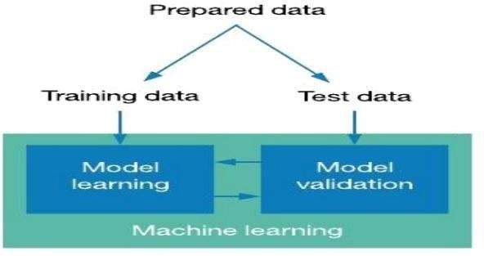
SPLITTING THE DATA SET

Slide 22
VARIOUS ALGORITHMS
LOGISITC REGRESSION
Logistic regression is one of the most popular Machine Learning algorithms under the Supervised Learning technique. It is used for predicting the categorical dependent variable using a given set of independent variables. It can be either Yes or No, 0 or 1.
SVM (SUPPORT VECTOR MACHINES)
Support vector machines (SVMs) are powerful yet flexible supervised machine learning methods used for classification, regression, and detection of outliers . SVM chooses the extreme points/vectors that help in creating the hyperplane. These extreme cases are called as support vectors, and hence algorithm is termed as Support Vector Machine.
[ Hyperplane – best decision boundary that helps to classify the data points]

Slide 23
K NEIGHBORS CLASSIFICATION
The K Nearest Neighbor algorithm falls under the Supervised Learning category. K-NN algorithm assumes the similarity between the new case/data and available cases and put the new case into the category that is most similar to the available categories.
Non-Linear ML Algorithms
DECISION TREE CLASSIFIER
A Decision Tree is a supervised learning technique It is a tree-structured classifier, where internal nodes represent the features of a dataset, branches represent the decision rules and each leaf node represents the outcome.

Slide 24
RANDBOM FOREST CLASSIFIER
Random Forest is a classifier that contains a number of decision trees on various subsets of the given dataset and takes the average to improve the predictive accuracy of that dataset. The greater number of trees in the forest leads to higher accuracy and prevents the problem of overfitting.
GRADIENT BOOSITING CLASSIFIER
Gradient boosting algorithm is one of the most powerful algorithms in the field of machine learning .It gives a prediction model in the form of an ensemble of weak prediction models, which are typically decision trees. When a decision tree is the weak learner, the resulting algorithm is called gradient-boosted trees
PREDICTION
Perform prediction of disease with given data using best suitable algorithm.

Slide 25
PERFORMANCE ANALYSIS
ALGORITHMS | ACCURACY
Logistic Regression | 79%
SVC (Support Vector Classifier) | 80%
K Neighbors Classifier | 74%

Slide 26
Non Linear ML Algorithms
ALGORITHMS | ACCURACY
Decision Tree Classifier | 73%
Gradient Boosting Classifier | 80%
Random Forest Classifier | 85%

Slide 27
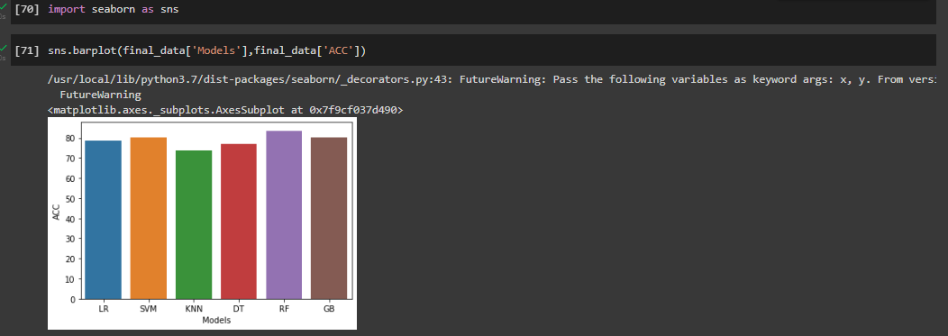
OUTPUT SCREENSHOTS
BEST ALGORITHM – RANDOM FOREST CLASSIFIER

Slide 28
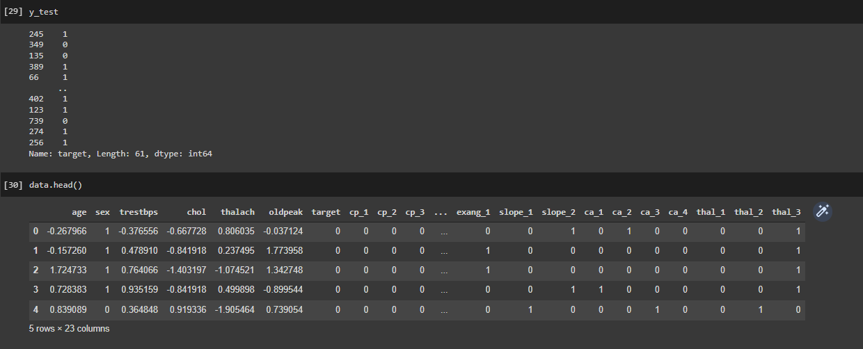
FEATURE SCALING

Slide 29
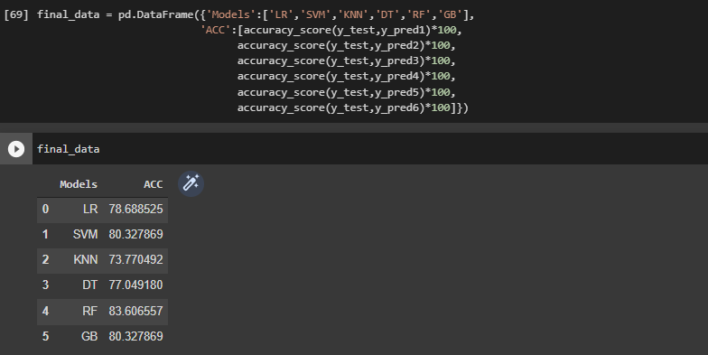
ACCURACY

Slide 30
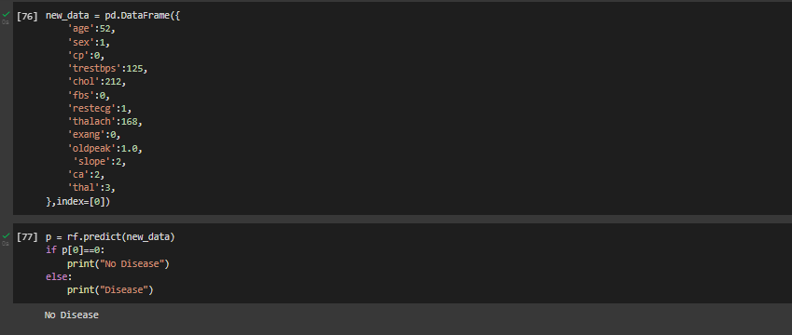
DETECTION OF DISEASE

Slide 31
CONCLUSION
Performed Data processing (preprocessing) by separating categorical columns and numerical columns.
We also did a complete feature scaling part for those algorithms which needed to be done feature scaling and accuracy of each algorithm mentioned are compared .
From the above model accuracy, Random Forest Classifier has 85% of accuracy .
Thus trained the model and is saved to perform predictions in future .

Slide 32
REFERENCES
Senthilkumar Mohan;Chandrasegar Thirumalai;Gautam Srivastava . Effective Heart Disease Prediction Using Hybrid Machine Learning Techniques . Year 2019 . Available from https://ieeexplore.ieee.org/document/8740989
Jian Ping Li; Amin Ul Haq; Salah Ud Din; Jalaluddin Khan; Asif Khan; Abdus Saboor .Heart Disease Identification Method Using Machine Learning Classification in E-Healthcare .
Year 2020 . Available in :https://ieeexplore.ieee.org/document/9112202
Norma Latif Fitriyani;Muhammad Syafrudin;Ganjar Alfian;Jongtae Rhee HDPM: An Effective Heart Disease Prediction Model for a Clinical Decision Support System
Year 2020 . Available in : https://ieeexplore.ieee.org/document/9144587
Sarria E. A. Ashri; M. M. El-Gayar; Eman M. El-Daydamony. HDPF: Heart Disease Prediction Framework Based on Hybrid Classifiers and Genetic Algorithm .
Year 2021 . Available in :https://ieeexplore.ieee.org/document/9585496
Mohammad Ayoub Khan;Fahad Algarni . A Healthcare Monitoring System for the Diagnosis of Heart Disease in the IoMT Cloud Environment Using MSSO-ANFIS . Year 2020 . Available in : https://ieeexplore.ieee.org/document/9131756

Slide 33
THANK YOU

